Slide 1

Notes for Facilitators
1/3
Read before presenting
These topics are sensitive to some people and the way you facilitate these presentations is important. Please ensure you are hosting these topics in a safe and considerate environment.
Remember to touch on confidentiality, and address the Duty to Report. It is important for those participating to feel this is a safe space, and be aware of what that entails.
  The Children and Family Services Act, states that everyone has a duty to report a child that is in need of help. Facilitators have a duty to report if there is a belief that child is being (or has been) neglected or abused (sexually, physically or emotionally). A child is considered anyone 19 and under if the abuser is a family member, and 16 and under if the abuser is a non-family member.

Slide 2

Notes for Facilitators
2/3
Set rules for the space. Ensure that those within the space are coming up with the rules to allow for buy in from the group. The following are some suggestions:
      Feel free to take a step out of the space if needed
      Feel free to pass when you do not want to or feel comfortable sharing
      Speak for your own experiences
      Take the lessons, not the details
      Be aware of your impact
  Frame above as a base then you can ask if participant have any other rules, this aids in buy-in, especially if you are presenting to school-aged youth.

Slide 3
Notes for Facilitators
3/3
Not everyone is binary and/or their gender expression may not match with the stereotypical pronouns you think to use. Ensure you are being respectful of everyones pronouns, it’s better to ask than to guess incorrectly.
Broadly define relationships by refraining from binary and heteronormative language and examples.
Remember that gender identity and gender expression are different from sexual orientation.
Some topics may bring back trauma, it may help to have 2 presenters so one can check-in on people who need to leave the room.
    A content warning example can be seen below:
        “Some topics touched on in this presentation can bring trauma back to the surface. If you feel like you need to leave the area or need a break please just step out.”

Slide 4

Communication
Youth Health and Support Centre
The Red Door: Youth Health and Support Centre

Slide 5

What is communication?
Communication is all the spoken and non-spoken cues that allow for someone to understand what we mean.
Notes:
This means what someone says also what people don’t say. What they are doing with their body matters, do they look receptive or unreceptive, are they smiling or frowning. A lot of how we communicate is unspoken.

Slide 6
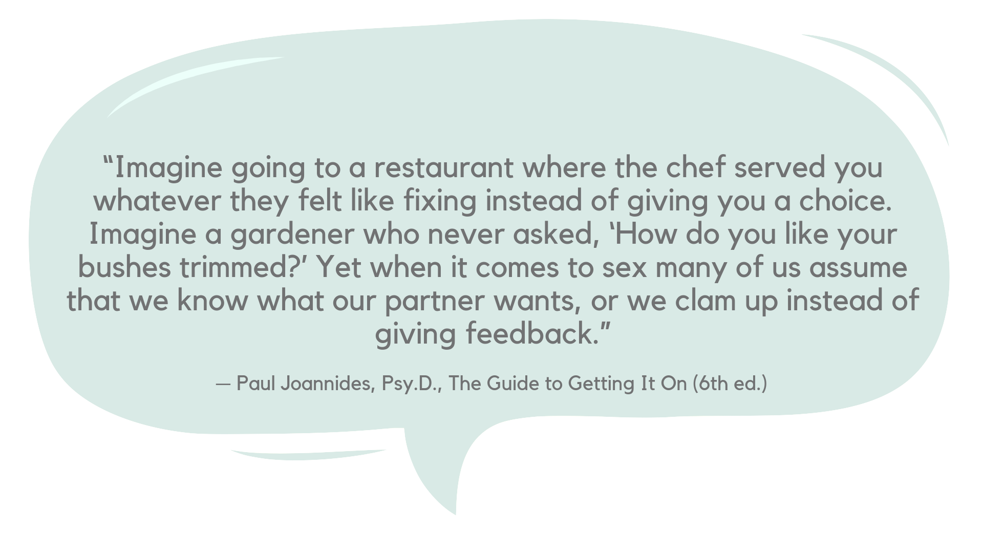

Slide 7
Communication and Sex
Communication is important for a positive and consensual sexual experience.
By communicating you not only get to know the needs of your partner, but also the wants.
Communication and consent can be really sexy, and help make your sex better!

Slide 8
Consent
YES!
Consent is needed for any sex act. Kissing, touching, oral, penetrative, ANYTHING that could be considered a sexual experience.
Silence does not equal consent. Consent is both verbal and non-verbal, and must be voluntary and expressed clearly through words and/or actions. Consent must given by all people involved.
A person must consent at each stage of the sexual activity.

Slide 9
Consent
YES!
Consent can be withdrawn at any time. If someone said yes before sex, but then changed their mind to a no — there is no longer consent.
Whenever there is no longer consent you should STOP. You should make sure the other person is OK, comfortable and safe.
If you (or the person you are with) does not stop, this is sexual assault and/or rape. You can report this and should see a Sexual Assault Nurse.

Slide 10
Consent
YES!
If a person is in a position of authority or trust (i.e. teacher and/or boss) there is not consent due to their position.
Consent becomes invalid as soon as a person loses the ability to consent, as in the case of intoxication with drugs and alcohol.
A coerced or forced yes is not consent. If consent is given out of fear and/or because of force and/or threats, the consent is not legal.

Slide 11
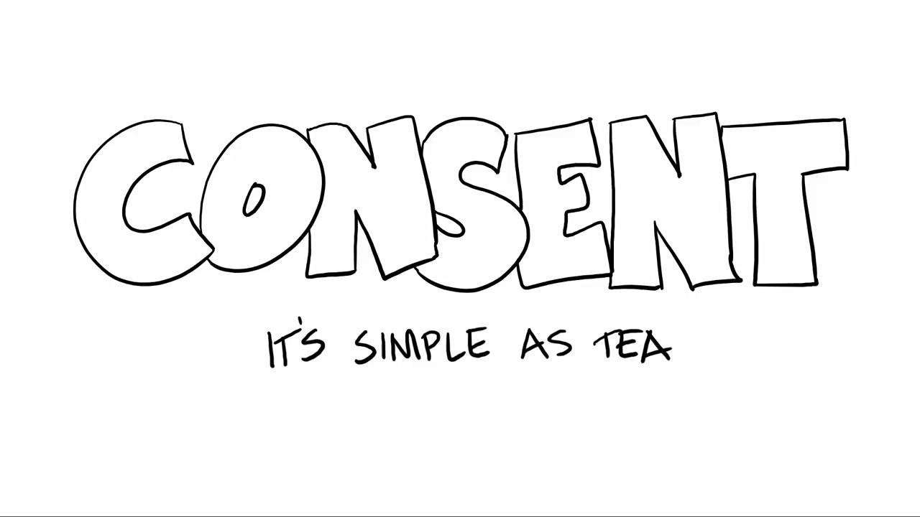
Copyright ©2015 Emmeline May and Blue Seat Studios
https://www.youtube.com/watch?v=fGoWLWS4-kU
Notes:
https://www.youtube.com/watch?v=fGoWLWS4-kU

Slide 12

Ways to communicate
There are two ways that you can communicate your wants to your partner.
The first, (and main way) is talking. The second way is writing.
You can always use a mix of these methods to have an even better understanding.

Slide 13
TALKING
WHEN: Before, During, and After
WHAT: Talk about use of barrier methods (dental dams, external/internal condoms), turn-ons, turn-offs, wants, and won’ts

Slide 14
Talking: an overview
Talking is one way to communicate with your partner during a sexual experience.
If you and your partner are having sex you both need understand the language you will be using and how to tell your partner to slow down, pause, or stop.
Notes:
If you are non-verbal there are other ways to communicate other than verbally talking, this is something you and your partner should review before commencing. You should be able to comfortably tell your partner if something hurts, if you want them to stop, or if you are happy with what’s happening.

Slide 15

Talking: Before
Before sex both you and your partner should have an understanding about what barrier methods you are choosing to use.
You can ask things like: “Do you have dental dams, or will we make some before hand?” OR “Do you need latex free condoms?”

Slide 16
Talking: Before
You can also learn what each others wants, wills and won’ts are from each partner. You can do this by having a discussion with your partner about what they want during sex.
You can say things like “Would you like me to give you oral?” OR “I don’t like my hair pulled during sex, though I do like my neck kissed”
Notes:
Want/wills/won’ts will be explained in the future

Slide 17
Talking: During
During sex you and your partner should tell each other if something hurts, if something needs to change, if you want something to change, or if you want to stop.
You can do this by saying things like “I don't like that, can we do this” OR “I like that” OR “Stop”
Notes:
Remember if you or your partner says stop all sex should stop and you should make sure your partner is okay, safe, and comfortable

Slide 18
Talking: After
After you have sex you can talk about the things you liked, the things you did not like, and things you would like to try next time.
This can be done by saying things like “I really liked how you did that, maybe next time try more of that.” OR “I didn’t really like it when you did that, next time we can avoid that”.

Slide 19
Writing
WHEN: Before, and After
WHAT: Do a Want/Will/Won’t chart

Slide 20
Writing: an overview
Writing can sometimes be less intimidating and when mixed with talking can allow for better understanding.
It is important to communicate whatever you write for your partner, just in case they don’t understand what had been written.

Slide 21
Writing: An important note
It is very important that if you do a want/will/won’t chart that you ALSO communicate about what you write.
If you are ever unclear about what your partner means ALWAYS ask for clarification.

Slide 22
Writing: Want/Will/Won’t
A want/will/won't list is a great way to communicate with you partner about the wants and needs of a sex experience.
Wants are those things that you expect or want from sex.
Wills are those things that you are willing or okay with doing but things you aren’t expecting, or things you want to try.
Won’ts are those things that you are not willing or wanting from sex. Things you will not do or do not want to do.

Slide 23
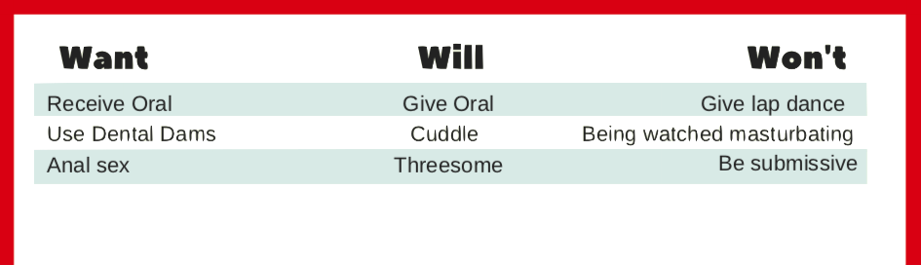
Writing: Want/Will/Won’t
A want/will/won’t chart can be as long as you want. You can create your own or find a template online.

Slide 24
Writing: Want/Will/Won’t
It is important to update the list as your desired activities shift.
Whenever you update your list, you need to let your partner know, maybe even get them to update theirs.
Remember to exchange your new list and talk about them.

Slide 25
During Sex
IF SOMETHING IS UNCOMFORTABLE, NOT WORKING, OR YOU WANT TO STOP YOU NEED TO LET YOUR PARTNER KNOW.
That hurts…
Let’s try something else.
Of course! Can we try….

Slide 26

During Sex
Some people during sex use different ways to indicate to their partners if they want to continue, slow down, or stop.
However you decide to communicate, it should be clear for yourself and your partner BEFORE you start, so if you want or need to stop it is clear.

Slide 27
It’s
Practice
Time!
Notes:
In the following slides there will be many examples given. At the end of the example there will be time to discuss how one person may communicate with their partner.
Give people time to answer then go onto the next slide for the suggested response. This can either been done in small group settings or as a large group responding.

Slide 28
Activity 1
Pat was going to her partner’s for the night. Sam was excited to be able to use the sex toys she bought. Sam had some ideas for how the experience would go and shared some of her ideas with Pat. Pat was very excited to be able to have sex with Sam tonight, but didn’t want to use some of the sex toys Sam had purchased.
How should Pat tell Sam that she is not wanting to do some of the sex acts she told her about?

Slide 29

Activity 1
Pat should ask Sam to discuss the sex act. For example if Pat doesn't want to use a butt plug then Pat can say something like, "You sound very excited for this afternoon, I am too, I just think maybe we should touch base on what we want and are willing to do first. You've mentioned to me about using a butt plug and I’m not willing or comfortable using one."
Notes:
However Pat brings it up Sam should respect her decision and desire to not want to use whichever toy she has spoken about. Sam should not pressure Pat into trying it, Pat has spoken and her decision should be respected.

Slide 30
Activity 2
Jo and Mo went on vacation together. Mo had booked a nice cottage and was excited to spend the weekend with his partner. Jo was also excited that Mo and him could spend some time together. Upon arrival Jo suggested that Mo and him have sex. Mo wasn’t feeling like sex at the moment.
How can Mo tell his partner that he wasn’t feeling it?

Slide 31
Activity 2
Mo should tell Jo that he wasn't feeling up to sex right now. He doesn't have to say maybe later, or apologize. Simply: "Hey Jo, I'm not feeling it right now…”
He could also offer an alternative activity to do. He could say “Jo, I’m not up to sex right now. Maybe we could go for a walk instead…”
Notes:
Just because they are on a romantic vacation doesn’t mean Mo or Jo owe each other anything. Jo should respect Mo’s decision to not be interested in sex and make sure he is comfortable.

Slide 32
Activity 3
Rylie was talking with a person that they were interested in having sex with. Rylie had made plans to go over to hook-up later that night with her. Remi was excited that they wanted to hook up and cleaned her entire room for them. Shortly after Rylie arrived they started kissing Remi. Things got a little steamy, but Remi wasn’t feeling it and wanted to stop.
How can Remi tell Rylie that she doesn’t want to continue?

Slide 33
Activity 3
Remi can say stop. When she says stop Rylie should not continue and they should ensure Remi is okay and comfortable.
Remi can say "I know we talked about hooking up, but right now I am not wanting to go further". Rylie should respect any decision they come to about continuing to have sex.
Notes:
Regardless of previous discussion about hooking up sex does not have to happen. Mid hook up one person can say stop and all people involved should stop. The important thing is making sure the partner wanting to stop is safe, comfortable and okay. Rylie should make sure Remi is safe and comfortable.

Slide 34
Activity 4
Reese and Dakota were mid hook-up. Dakota was wanting to perform oral on Reese. Dakota knew if there was any unknown STIs, that they could be passed if they
didn't use a barrier method. They wanted to make sure they used a dental dam while giving oral because they wanted to ensure that they were both being safe...
How can Dakota ask for a dental dam?
How can Dakota set boundaries of needing barrier methods?

Slide 35
Activity 4
Dakota could pull away or pause the current activity and ask "do you have a dental dam”. If Reese did not then Dakota should say something like, "I want to give you oral but I want to make sure we are both safe so I want a barrier method. Do you have a condom I could make into one?".
Either well before hooking up or just before hooking up they both should discuss their needs for a barrier method and who will be bringing them, or if both parties will bring some. This ensures they will have them when they need them.
Notes:
Barrier methods are really important. If someone says they want to use barrier methods you should use barrier methods, this is a safe tool to ensure you are not receiving or giving STIs. The act of sheathing, removing a condom while the partner still believes you are wearing it, is deceitful and is not consensual.
If you or your partner wants to wear barrier methods you should respect their decision.

Slide 36
Activity 5
Amari and Quinn had just gone on a wonderful sushi date. Quinn paid for dinner, then invited Amari back for coffee at her place. She was thrilled when he said yes. They got back to Quinn’s place. Soon enough they were making-out. Amari didn’t want things to go further and when he felt her hand near his waistline he pulled away...
What should Amari say to Quinn?

Slide 37
Activity 5
Amari should tell Quinn that he didn't want things to go further. He could phrase this many ways. One way is to stop kissing Quinn, pull away and say "I've had a good time tonight but I do not want to do any more than kiss”.
At this point, Amari can decide if he wants to stay or leave. Quinn should respect any decision he makes.
Notes:
Just because Quinn paid for dinner doesn’t mean Amari owes Quinn. Whatever decision about staying or going should be respected by both parties.

Slide 38

Thank You!
Presentation created by:
The Red Door
Kentville NS
www.thereddoor.ca
Notes:
Sources:
—
https://www.sexandu.ca/consent/what-is-consent/
https://www.educaloi.qc.ca/en/capsules/consent-sexual-activities
http://www.scarleteen.com/article/advice/yes_no_maybe_so_a_sexual_inventory_stocklist
http://www.catherinecoaches.com/pdf/WWWchartsfreedownload.pdf

