Slide 1

Notes for Facilitators
1/3
Read before presenting
These topics are sensitive to some people and the way you facilitate these presentations is important. Please ensure you are hosting these topics in a safe and considerate environment.
Remember to touch on confidentiality, and address the Duty to Report. It is important for those participating to feel this is a safe space, and be aware of what that entails.
  The Children and Family Services Act, states that everyone has a duty to report a child that is in need of help. Facilitators have a duty to report if there is a belief that child is being (or has been) neglected or abused (sexually, physically or emotionally). A child is considered anyone 19 and under if the abuser is a family member, and 16 and under if the abuser is a non-family member.

Slide 2

Notes for Facilitators
2/3
Set rules for the space. Ensure that those within the space are coming up with the rules to allow for buy in from the group. The following are some suggestions:
      Feel free to take a step out of the space if needed
      Feel free to pass when you do not want to or feel comfortable sharing
      Speak for your own experiences
      Take the lessons, not the details
      Be aware of your impact
  Frame above as a base then you can ask if participant have any other rules, this aids in buy-in, especially if you are presenting to school-aged youth.

Slide 3
Notes for Facilitators
3/3
Not everyone is binary and/or their gender expression may not match with the stereotypical pronouns you think to use. Ensure you are being respectful of everyones pronouns, it’s better to ask than to guess incorrectly.
Broadly define relationships by refraining from binary and heteronormative language and examples.
Remember that gender identity and gender expression are different from sexual orientation.
Some topics may bring back trauma, it may help to have 2 presenters so one can check-in on people who need to leave the room.
    A content warning example can be seen below:
        “Some topics touched on in this presentation can bring trauma back to the surface. If you feel like you need to leave the area or need a break please just step out.”

Slide 4

Gender Identity and Expression
Youth Health and Support Centre
The Red Door: Youth Health and Support Centre

Slide 5

What is Gender?
Is a socially constructed term to describe the identity of a person which is made up of behaviour, expression, identity, and how one interacts with the world. Usually it is looked at as binary (male/female), but gender is much more diverse.

Slide 6
What is a gender binary?
WHAT: Gender binary is a system which pairs biological sex (genitals) with gender, either male or female.
Gender binary doesn’t acknowledge the full gender spectrum and is defined by male/female.

Slide 7
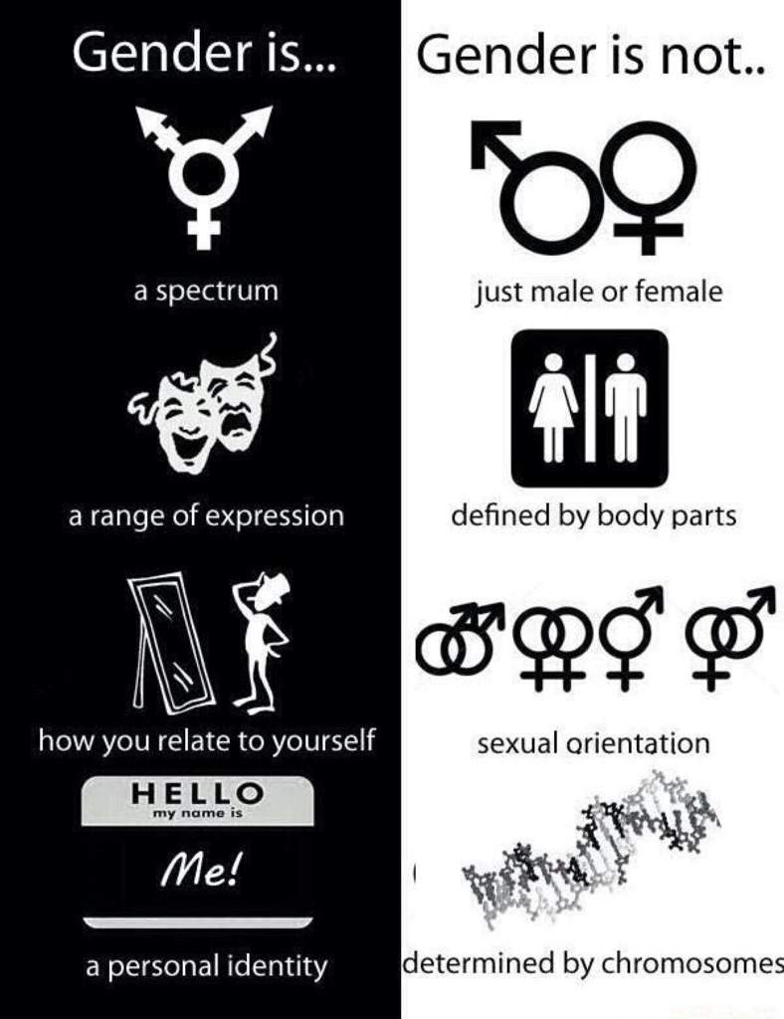
source: http://www.soc.ucsb.edu/sexinfo/article/gender-binary

Slide 8
What is Gender Identity?
Gender identity refers to how a person sees themselves in terms of gender. Their gender identity may or may not align with the birth-assigned sex.

Slide 9
What is Gender Expression?
Gender expression is how one expresses their identified gender, typically through how one dresses, appears and/or acts.

Slide 10
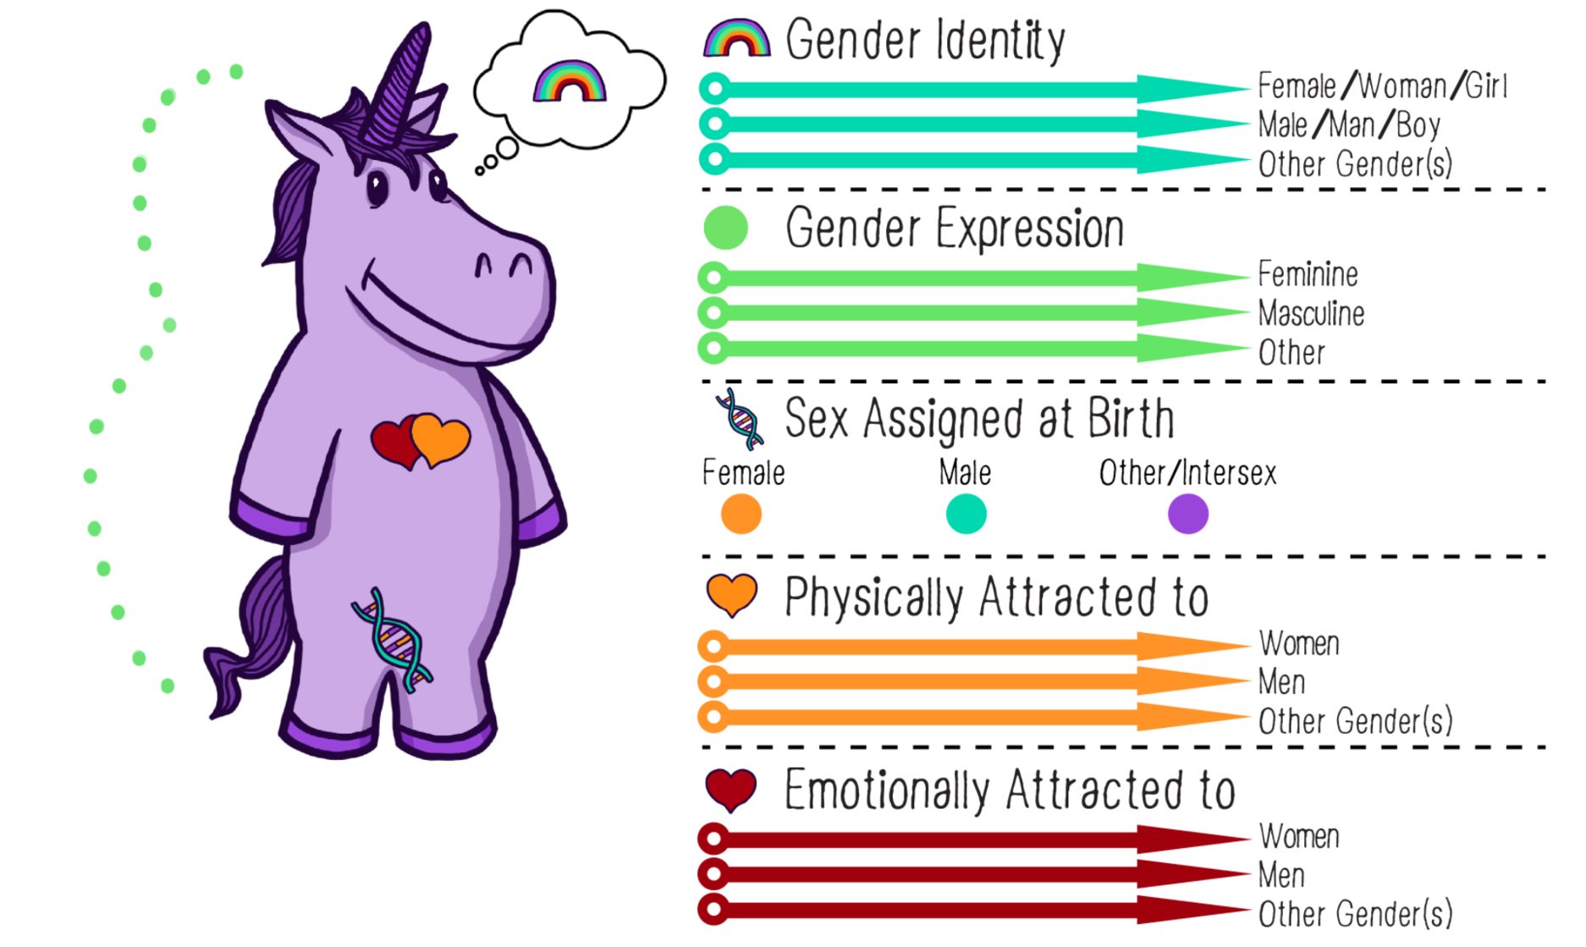
Gender Unicorn

Slide 11
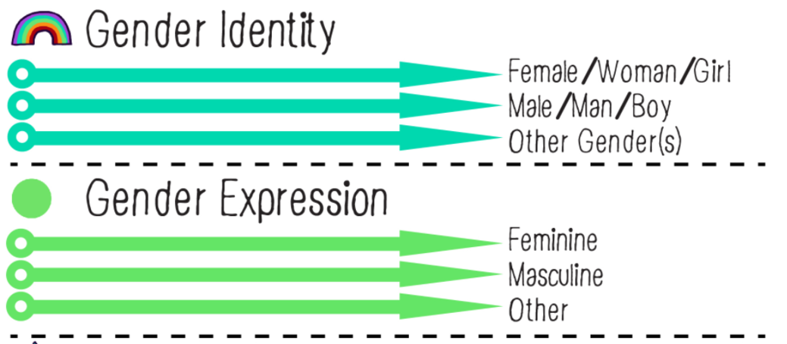
Agender
a term which describes someone who sees themselves as existing without gender, sometimes also described as gender neutral or genderless.

Slide 12
Bigender
This is a term that describes someone who fluctuates between traditional woman and man gender based identities.

Slide 13

Cisgendered
This is a term that describes someone who identifies with the sex they were assigned at birth

Slide 14
Demigender
This is a term describes a person who only has a partial connection to a certain gender. Terms demiboy, demigirl are also frequently used under this gender identity.

Slide 15
Gender Fluid
Day X
Day Y
This is best described as a dynamic mix of boy and girl. A person who is gender fluid may always feel like a mix of the two traditional genders, but may feel more man some days, and more woman other days.

Slide 16
Gender Neutral
This is a term which describes someone who sees themselves as existing without gender, sometimes also described as agender or genderless.

Slide 17
Gender Queer
This is a term that describes someone whose gender identity is not fitting within the binary of man/woman.
This term can also be an umbrella term for many non-conforming or non-binary identities.

Slide 18
Non-binary
This is a term that describes someone who doesn’t identify as simply female or male.

Slide 19
Polygender
This is a term that describes someone who identifies with several different genders either at the same time or at different times.

Slide 20
Transgender
This is a term is typically an umbrella term that describes someone whose gender identity is different that their sex assigned at birth.

Slide 21
Androgynous
This is a term which describes someone who sees themselves as a gender expression that has elements of both masculinity and femininity without gender.

Slide 22
Butch
This is a term that describes the gender expression of a person who identifies themselves as female/woman but expresses their gender with more masculine characteristics.

Slide 23
Femme
This is a term that describes the gender expression of femininity

Slide 24
Gender Conforming
A term that describes a person whose gender expression matches their gender identity.

Slide 25
Gender Non-Conforming
A term that describes a non-traditional gender expression. For example masculine woman, or feminine man.
This also can describe someone who identifies outside of a gender binary

Slide 26
Gender Normative
A term that describes a person whose gender expression aligns with societies gender based expectations

Slide 27
Pronouns
Not everyone uses binary pronouns. There are some alternative pronouns that you or others may use. If you are ever unsure about someone’s pronoun it is better to ask than to assume.
What are your pronouns? I use he/him.
I use they/them.

Slide 28
She/Her
These are pronouns are usually used for someone who identifies as female.

Slide 29
Ze/Zir [zee, zerr, or zeer]
These are alternative gender neutral pronouns that replace he, she, his, and hers.

Slide 30
Him/His
These are pronouns usually used for someone who identifies as male.

Slide 31
They/Their
These are alternative gender neutral pronouns that replace he, she, his, and hers.

Slide 32
Important Point
The way someone expresses their gender may not fit socially constructs of what pronouns to use. Never assume someone’s pronouns based on their gender expression!

Slide 33

Thank You!
Presentation created by:
The Red Door
Kentville NS
www.thereddoor.ca
Notes:
Sources:
https://www.genderspectrum.org/quick-links/understanding-gender/
http://teentalk.ca/learn-about/gender-identity/
https://www.sexandu.ca/lgbttq/gender-identity/
https://www.cbsnews.com/news/transgender-gender-identity-terms-glossary/

